Slide 1
RESIDENTIAL LOTS FOR SALE

Slide 2
LOCATIONS
Bulacan
Laguna
Rizal
Cavite

Slide 3
bulacan
COLINAS VERDES RESIDENTIAL & COUNTRY CLUB
San Jose Del Monte, Bulacan
http://colinasverdes.opmc.ph/index.php
LOT AREA : 212 sq.m
PRICE/SQ.M. : 6,400
LOCATION : PH1 BLK 75 LOT 45
LOT TYPE : INNER LOT

Slide 4
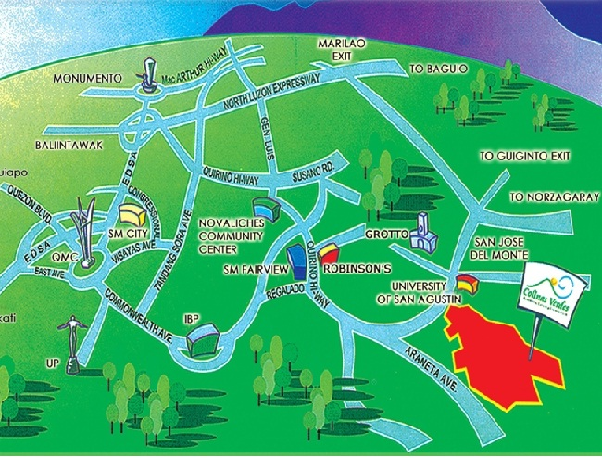
VICINITY MAP

Slide 5
AMENITIES

Slide 6
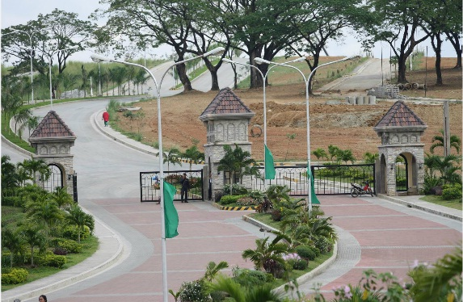
PHOTOS

Slide 7
PHOTOS

Slide 8
LAGUNA
CARMEL RIDGE RESIDENTIAL ESTATES
Carmelray Industrial Park II,
Calamba, Laguna
http://carmelridge.opmc.ph/index.php
LOT AREA : 153 sq.m
PRICE/SQ.M. : 6,400
LOCATION : PH1 BLK 3 LOT 38
LOT TYPE : INNER LOT
LOT AREA : 150 sq.m
PRICE/SQ.M. : 6,400
LOCATION : PH1 BLK 3 LOT 39
LOT TYPE : INNER LOT
LOT AREA : 150 sq.m
PRICE/SQ.M. : 6,400
LOCATION : PH1 BLK 4 LOT 21
LOT TYPE : INNER LOT
LOT AREA : 158 sq.m
PRICE/SQ.M. : 6,600
LOCATION : PH1 BLK 4 LOT 20
LOT TYPE : CORNER LOT

Slide 9
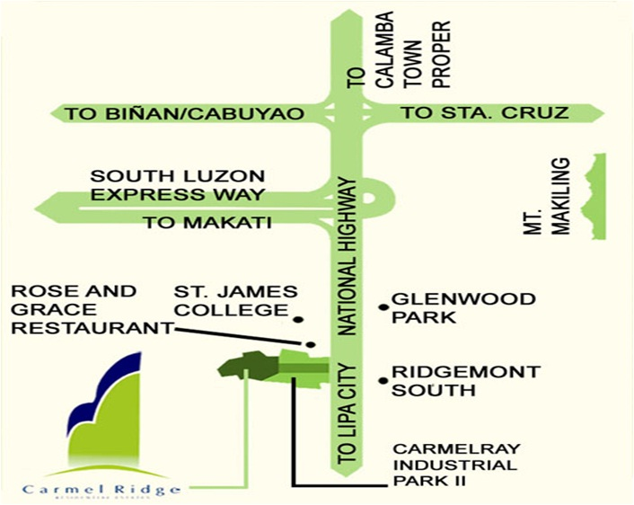
VICINITY MAP

Slide 10
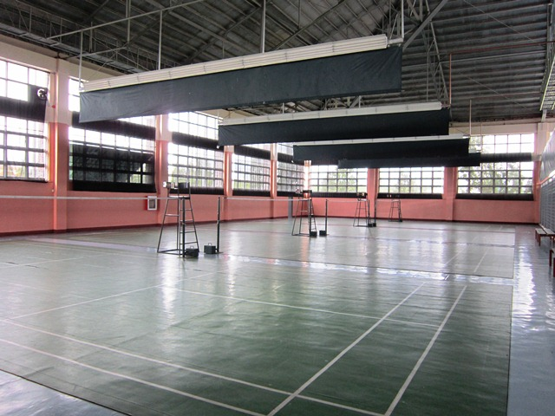
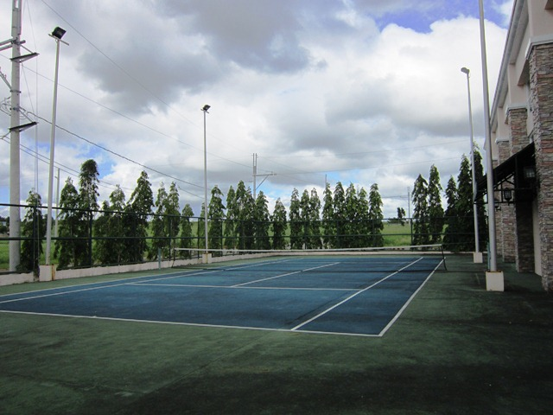
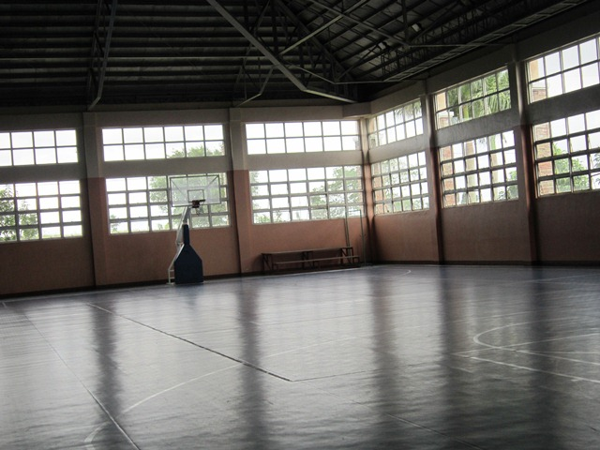
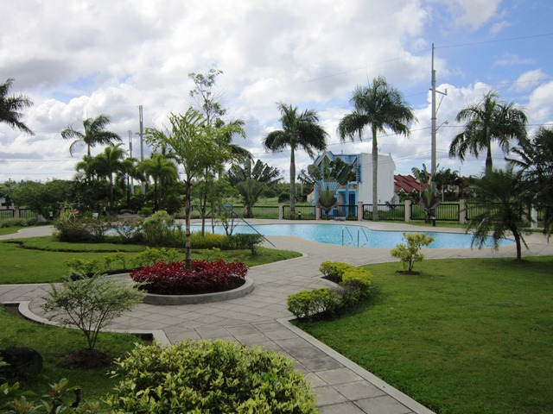
AMENITIES
Tennis Court
Badminton Court
Basketball Court
Swimming Pool

Slide 11
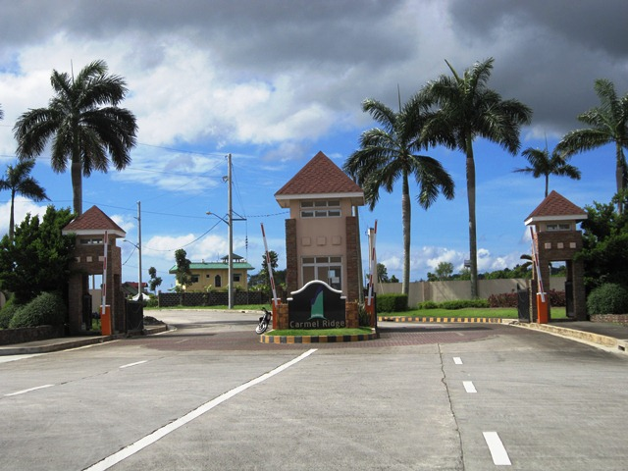
PHOTOS
Main Entrance Gate

Slide 12
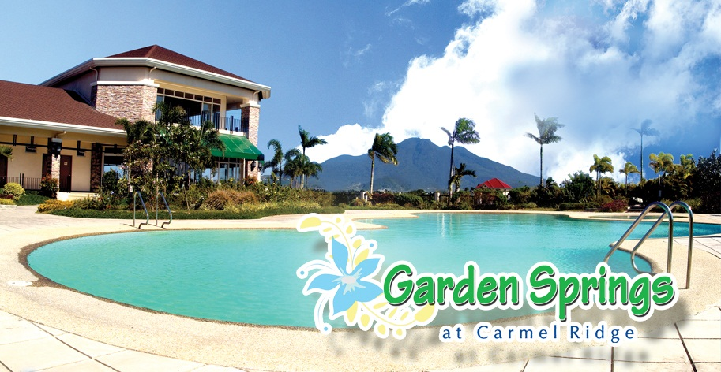
PHOTOS

Slide 13
LAGUNA
SOUTH SPRINGS RESIDENTIAL ESTATES
Barangay Canlalay, Binan, Laguna
http://southsprings.opmc.ph/index.php
LOT AREA : 198 sq.m
PRICE/SQ.M. : 6,600
LOCATION : PH1 BLK 3 LOT 38
LOT TYPE : INNER LOT
LOT AREA : 167 sq.m
PRICE/SQ.M. : 6,600
LOCATION : PH1 BLK 3 LOT 39
LOT TYPE : INNER LOT
LOT AREA : 190 sq.m
PRICE/SQ.M. : 6,600
LOCATION : PH1 BLK 4 LOT 21
LOT TYPE : INNER LOT
LOT AREA : 159 sq.m
PRICE/SQ.M. : 6,600
LOCATION : PH1 BLK 4 LOT 20
LOT TYPE : CORNER LOT

Slide 14
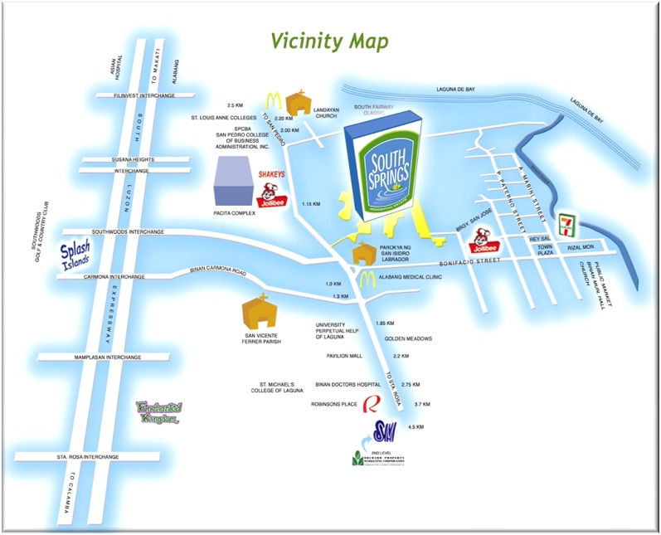
VICINITY MAP

Slide 15
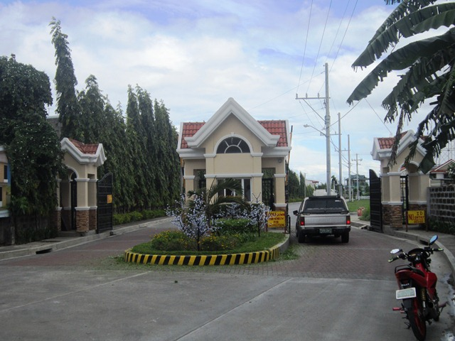
PHOTOS
Main Entrance Gate

Slide 16
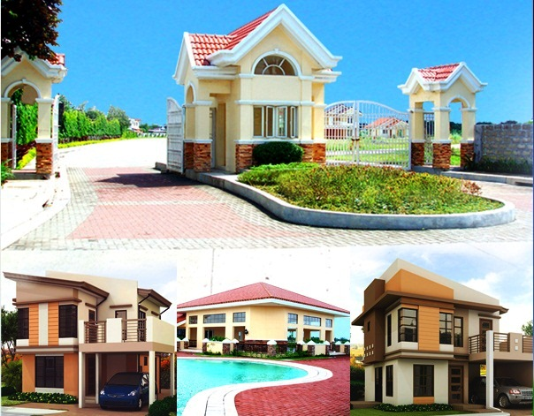
PHOTOS

Slide 17
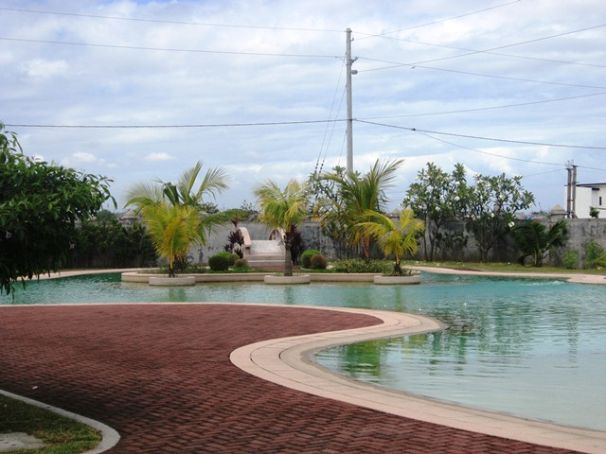
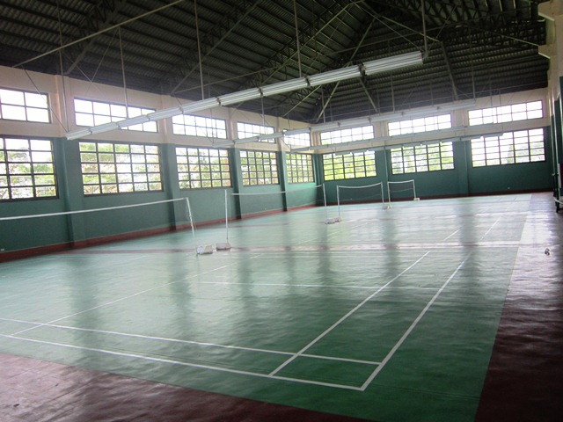
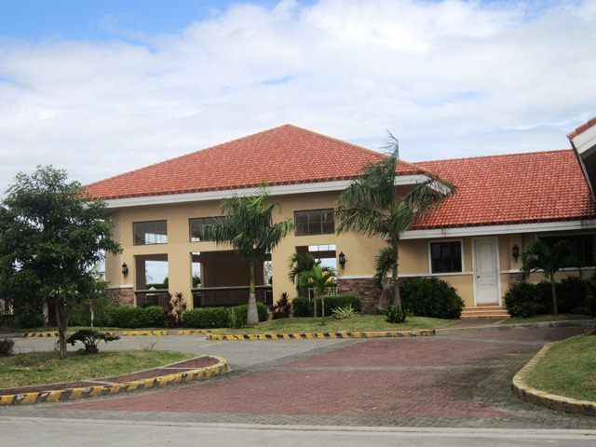
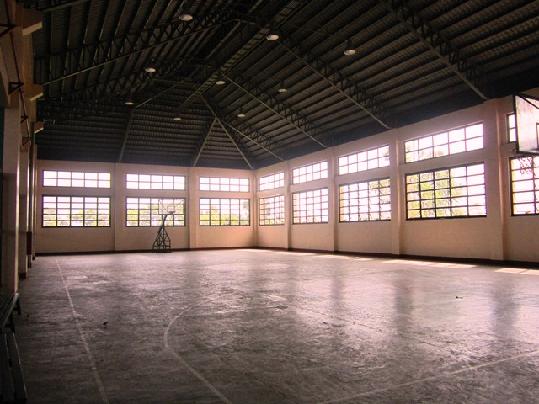
AMENITIES
Badminton Court
Swimming Pool
Basketball Court
Clubhouse

Slide 18
LAGUNA
GOLDEN MEADOWS RESIDENTIAL ESTATES
Biñan, Laguna
LOT AREA : 262 sq.m
PRICE/SQ.M. : 5,500
LOCATION : PH1 BLK 9A LOT 21
LOT TYPE : INNER LOT

Slide 19
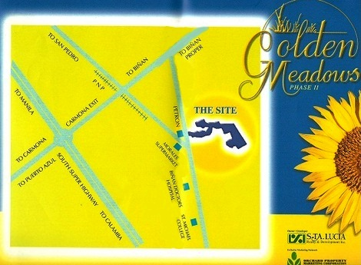
VICINITY MAP

Slide 20
AMENITIES
Multipurpose Clubhouse
Swimming pool
Basketball court
Landscaped entrance gate with guardhouse
Underground storm drainage system
Cemented sidewalks with promenade trees
Centralized interrelated water system with overhead water tank and deepwell
Cemented curbs and gutters
8-10-12 m, Wide concrete roads mercury lamps along the roads
Electrical facilities

Slide 21
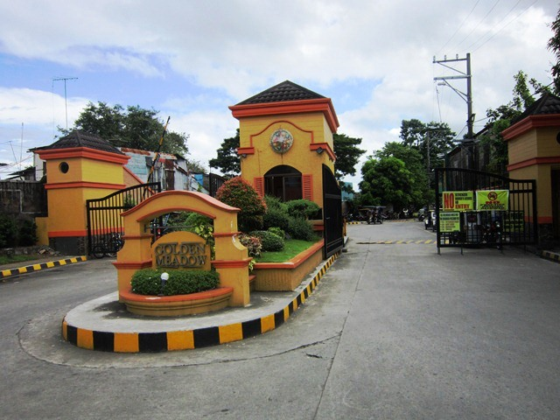
PHOTOS
Main Entrance Gate

Slide 22
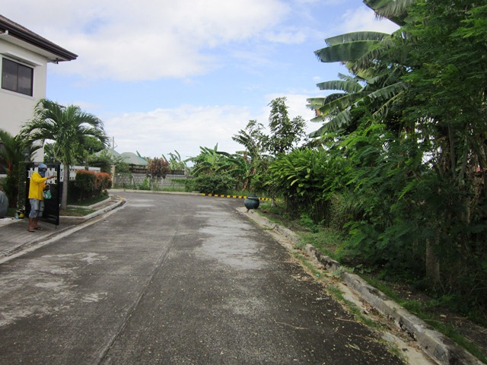
PHOTOS
Lot Location

Slide 23
RIZAL
VILLA VERDE EAST RESIDENTIAL ESTATES
Angono, Rizal
http://villaverdeeast.opmc.ph/index.php
LOT AREA : 206 sq.m
PRICE/SQ.M. : 5,900
LOCATION : PH1 BLK 12 LOT 17
LOT TYPE : INNER LOT
LOT AREA : 215 sq.m
PRICE/SQ.M. : 5,900
LOCATION : PH1 BLK 14 LOT 7
LOT TYPE : INNER LOT
LOT AREA : 183 sq.m
PRICE/SQ.M. : 5,900
LOCATION : PH1 BLK 13 LOT 23
LOT TYPE : INNER LOT
LOT AREA : 150 sq.m
PRICE/SQ.M. : 5,900
LOCATION : PH2 BLK 2 LOT 5
LOT TYPE : INNER LOT
LOT AREA : 219 sq.m
PRICE/SQ.M. : 6,100
LOCATION : PH2 BLK 2 LOT 2
LOT TYPE : CORNER LOT

Slide 24
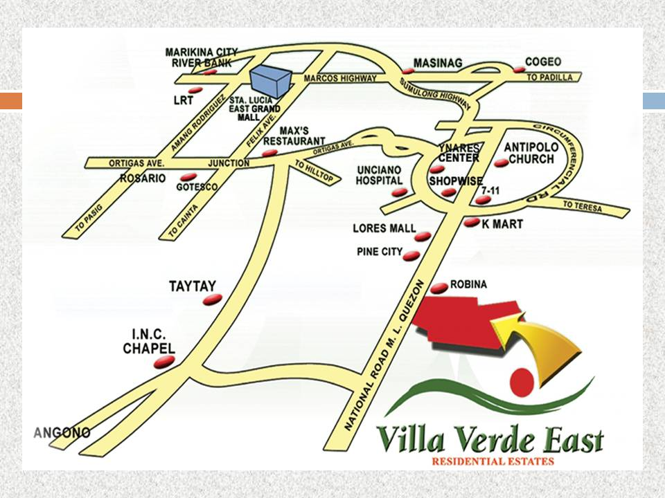
VICINITY MAP

Slide 25
AMENITIES

Slide 26
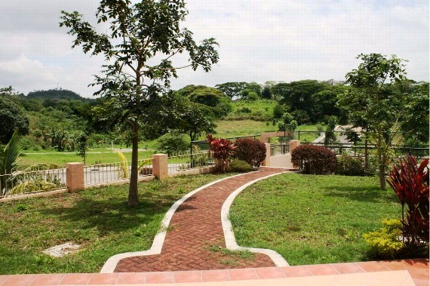
PHOTOS

Slide 27
RIZAL
PALO ALTO LEISURE & RESIDENTIAL ESTATES
Baras, Rizal
LOT AREA : 213 sq.m
PRICE/SQ.M. : 3,700
LOCATION : PH1 BLK 29 LOT 31
LOT TYPE : INNER LOT
LOT AREA : 392 sq.m
PRICE/SQ.M. : 3,900
LOCATION : PH1 BLK 81 LOT 31
LOT TYPE : CORNER LOT
LOT AREA : 415 sq.m
PRICE/SQ.M. : 3,700
LOCATION : PH1 BLK 23 LOT 19
LOT TYPE : INNER LOT

Slide 28
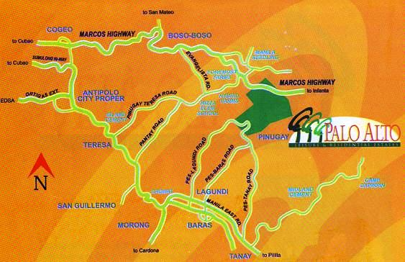
VICINITY MAP

Slide 29
AMENITIES
Landscape Entrance Gate w/ Guard House
Cemented Roads, Curbs and Gutters
Cemented Sidewalks w/ Promenade tress
Underground Storm Drainage.
Electrical Facilities
Landscaped Garden and Promenades
Centralized Interrelated Water System
Overhead Water Tank and Deep Well, Waterfalls
Clubhouse with Restaurant, Fitness Gym, Basketball Court, Tennis Court and Swimming Pool

Slide 30
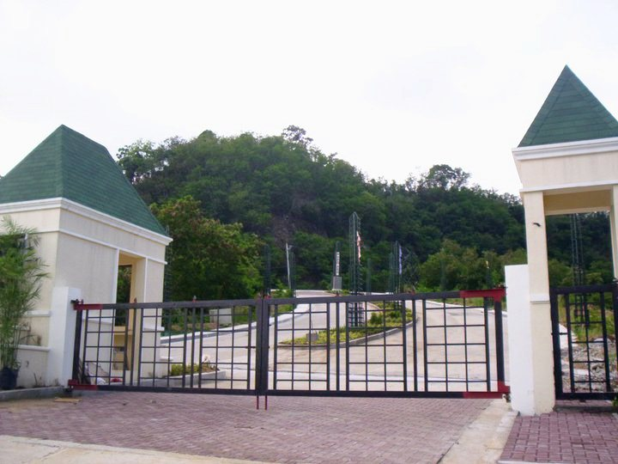
PHOTOS
Main Entrance Gate

Slide 31
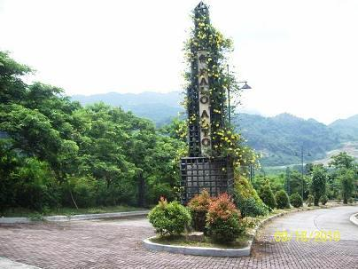
PHOTOS
Palo Alto’s Entry Statement

Slide 32
cavite
ROYALE TAGAYTAY RESIDENTIAL ESTATES PHASE 5
Alfonso, Cavite
LOT AREA : 180 sq.m
PRICE/SQ.M. : 4,800
LOCATION : BLK 4 LOT 22
LOT TYPE : INNER LOT
LOT AREA : 221 sq.m
PRICE/SQ.M. : 5,000
LOCATION : BLK 2 LOT 1
LOT TYPE : CORNER LOT
LOT AREA : 180 sq.m
PRICE/SQ.M. : 4,800
LOCATION : BLK 4 LOT 23
LOT TYPE : INNER LOT
LOT AREA : 217 sq.m
PRICE/SQ.M. : 4,800
LOCATION : BLK 2 LOT 3
LOT TYPE : INNER LOT

Slide 33
VICINITY MAP

Slide 34
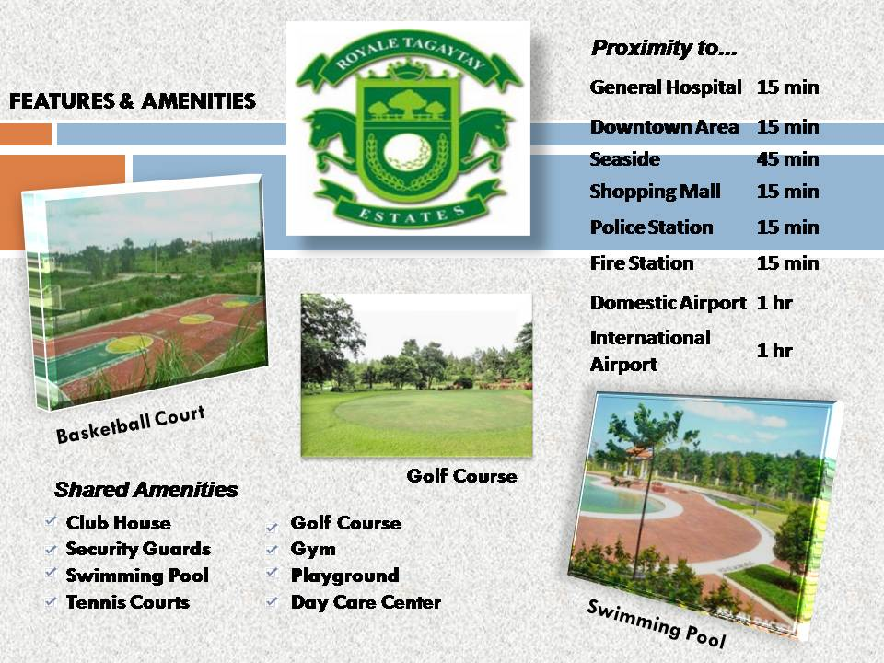
AMENITIES

Slide 35
PHOTOS

Slide 36
cavite
EAGLE RIDGE GOLF & RESIDENTIAL ESTATES
General Trias, Cavite
http://www.eagle-ridge.com.ph/
BLOCK | LOT | AREA | PRICE/SQM | LOT TYPE
96 | 56 | 996 | 4,800 | Standard Fairway
74 | 21 | 915 | 5,050 | Premium Fairway
74 | 22 | 1020 | 5,050 | Premium Fairway
28 | 3 | 768 | 4,800 | Standard Fairway
53 | 25 | 794 | 4,800 | Standard Fairway
111 | 7 | 319 | 4,300 | Standard Inner
28 | 46 | 787 | 4,800 | Standard Fairway
23 | 6 | 700 | 7,500 | Premium Commercial

Slide 37
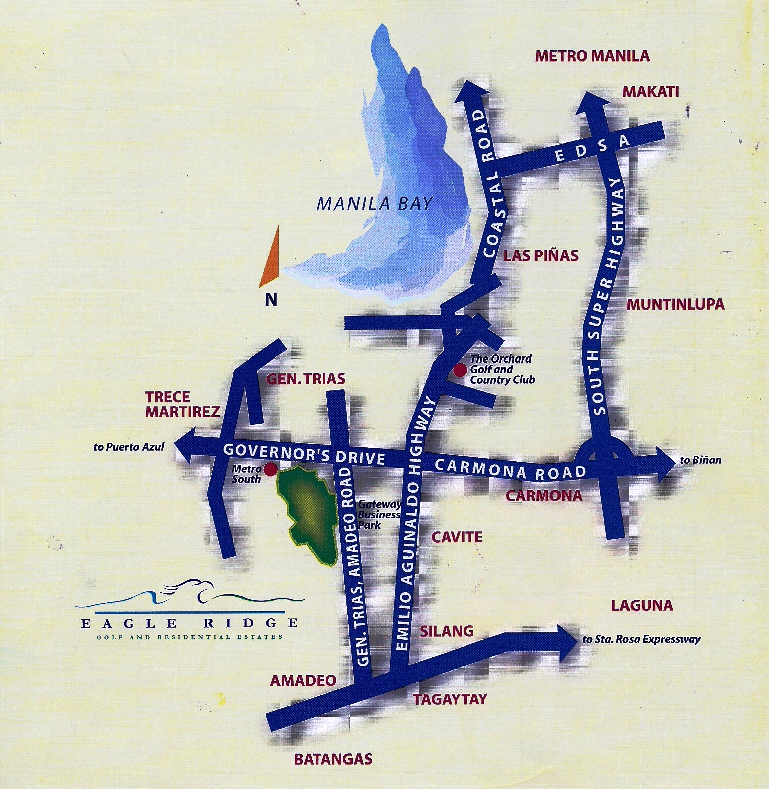
VICINITY MAP

Slide 38
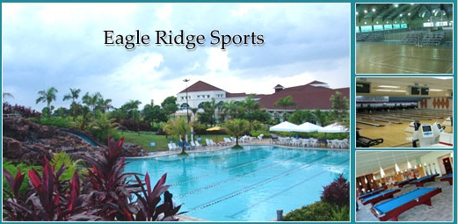
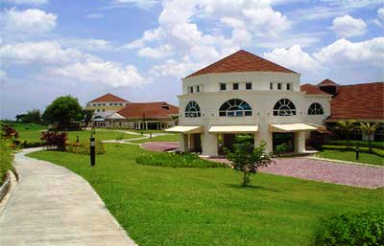
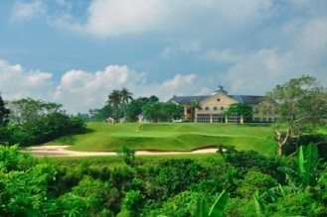
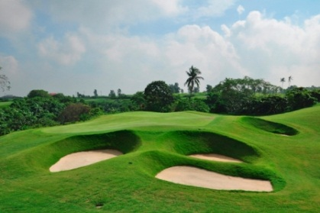
AMENITIES
Restaurants
Sports Club
Golf Courses
Country Club and Clubhouses

Slide 39
PHOTOS

Slide 40
PAYMENT SCHEMES
Scheme 1
Outright Cash: 15% Discount on the Total Selling Price
Scheme2
15% Discount on 50% Downpayment, 50% balance payable in 6 months
Scheme 3
20% Discount on 25% Downpayment, 75% balance payable in 12 months

Slide 41
PAYMENT SCHEMES
Scheme4
15% Discount on 20% downpayment, 80% payable in 2 years, no interest
Scheme5
5% Discount on Total Selling Price, payable equally in 12 months

